Slide 1

Network Port Scanner
Chirumamilla Gamana
AICTE ID: STU6815c625c40561746257445
Koneru Lakshmaiah Education

Slide 2

PROBLEM STATEMENT
In modern computer networks, identifying open ports and active services on a system is essential for security analysis, network management, and troubleshooting. However, many existing port scanning tools are either complex, command-line based, or not user-friendly for beginners.
There is a need for a simple, efficient, and user-friendly application that allows users to scan a target system for open TCP ports within a specified range. The tool should provide clear results, support multi-threaded scanning for faster performance, and offer a graphical interface to improve accessibility for non-technical users.

Slide 3
Project Description
The Network Port Scanner with Tkinter GUI is a Python-based application designed to analyze network systems by identifying open TCP ports on a given target. The primary goal of this project is to provide a simple, efficient, and user-friendly tool that enables users to perform port scanning without requiring advanced knowledge of command-line utilities or networking tools.
The application allows users to input a target system in the form of an IP address or hostname and define a specific port range (0–65535) to scan. Once initiated, the scanner performs a TCP connect scan using Python’s socket programming, where each port is tested to determine whether it is open or closed. Open ports indicate active services running on the target machine, which are essential for understanding network behavior and potential vulnerabilities.

Slide 4
Project Description
To improve performance, the system uses multi-threading, allowing multiple ports to be scanned simultaneously. This significantly reduces scanning time compared to traditional sequential scanning methods. The application includes an internal configuration for thread management and timeout handling, ensuring a balance between speed and system resource usage.
A key feature of this project is its Graphical User Interface (GUI) built using Tkinter. The GUI provides an intuitive environment where users can easily enter inputs, start scans, and view results in real time. It also includes a progress bar and elapsed time display, giving users clear feedback on the scanning process.
The scanner also incorporates a basic service mapping feature, where commonly used port numbers are associated with known services (e.g., HTTP, FTP, SSH). This helps users better understand the purpose of each open port without needing additional lookup tools.

Slide 5

WHO ARE THE END USERS?
IT engineers
SOC

Slide 6

Technology Used
Python 3.12
Tkinter (GUI)
Socket Programming
Multithreading
File Handling.

Slide 7
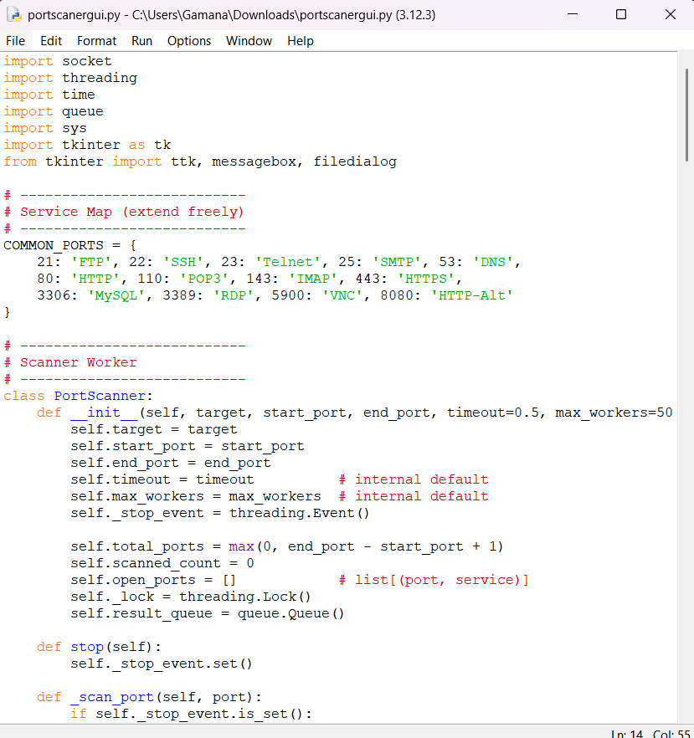
RESULTS
Demo Link

Slide 8
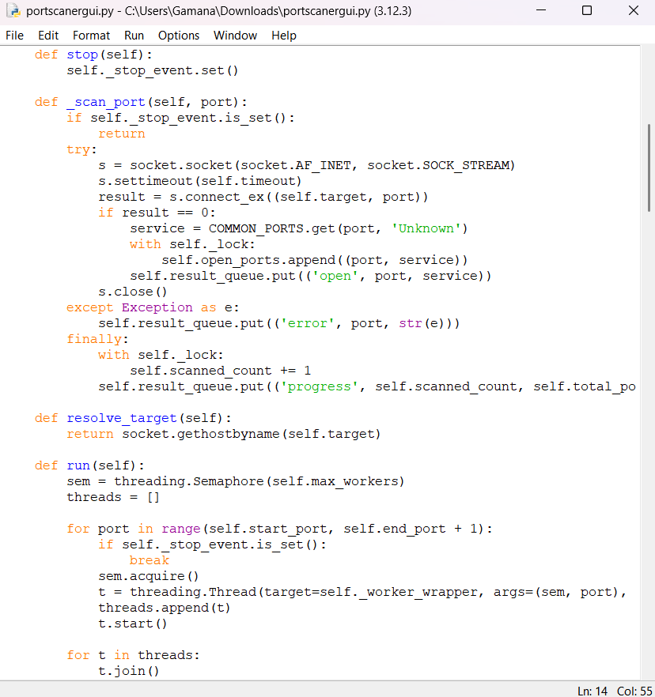
RESULTS
Demo Link

Slide 9
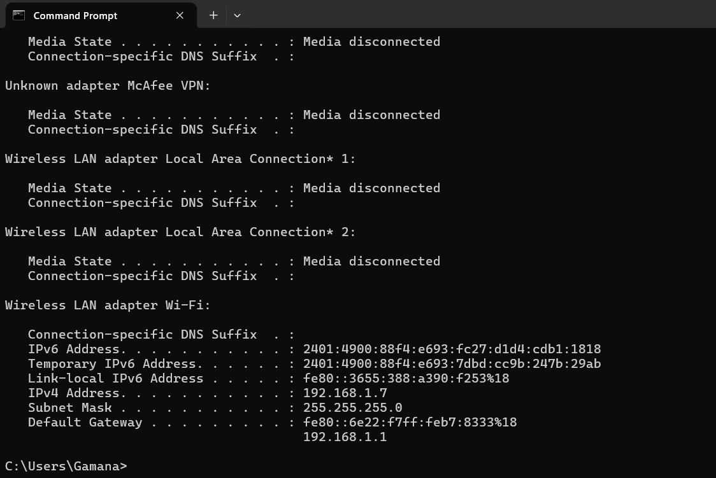
RESULTS
Demo Link

Slide 10
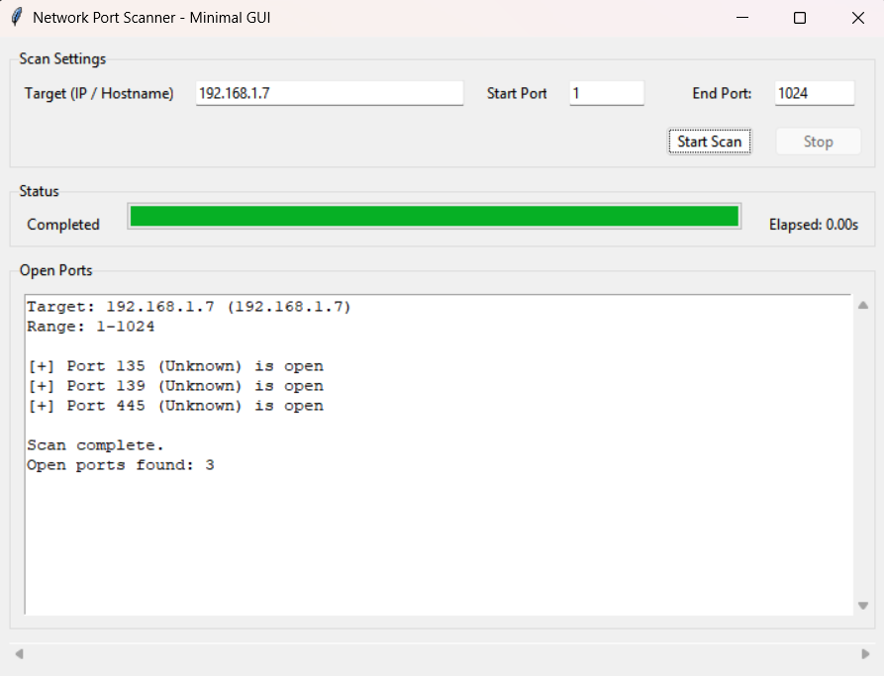
RESULTS
Demo Link

Slide 11
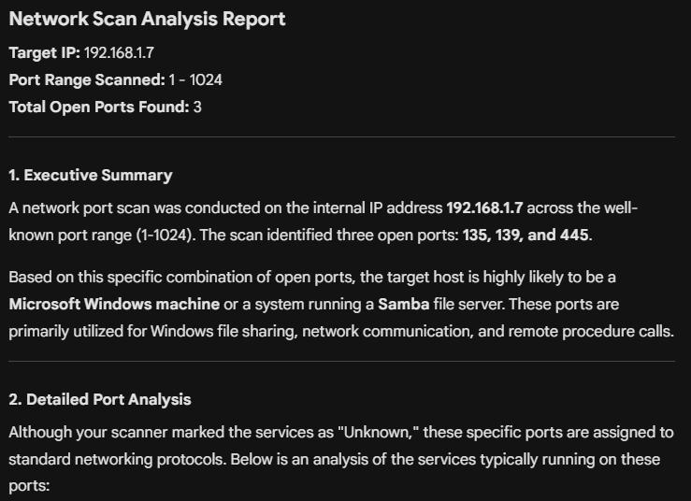
RESULTS
Demo Link

Slide 12
RESULTS
Port | Protocol | Typical Service | Description
135 | TCP | MSRPC | Microsoft Remote Procedure Call (RPC): Used by Windows to manage communication between applications across the network. It acts as an endpoint mapper, directing clients to the correct ports for various Microsoft services.
139 | TCP | NetBIOS-ssn | NetBIOS Session Service: Historically used in older Windows environments for file and printer sharing over a local area network (LAN). It allows applications on different computers to communicate within a local network.
445 | TCP | microsoft-ds | Server Message Block (SMB): The modern protocol used by Windows for file sharing, printer sharing, and accessing remote Windows services. SMB over port 445 operates directly over TCP/IP, removing the need for NetBIOS.
Demo Link

Slide 13
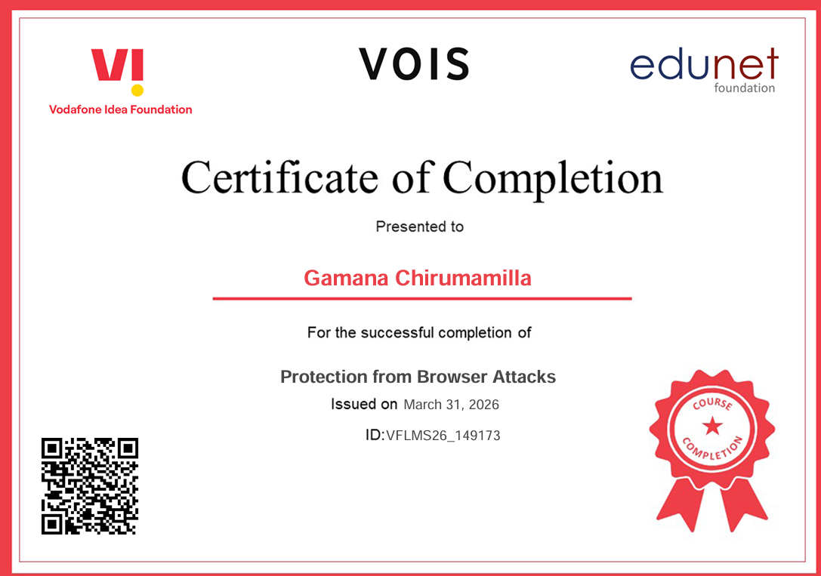
Certificate - Protection from browser attacks

Slide 14

Certificate - Introduction to System Security

Slide 15
GitHub link
https://github.com/gamana29/Network-Port-Scanner.git

Slide 16
Thank you
.
.

